Slide 1
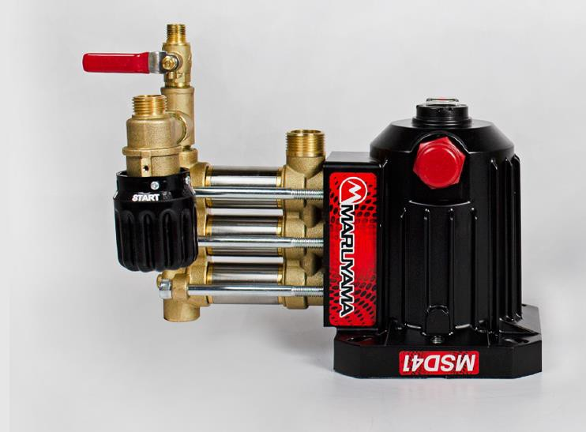
MSD41 Pump
Repair Manual

Slide 2
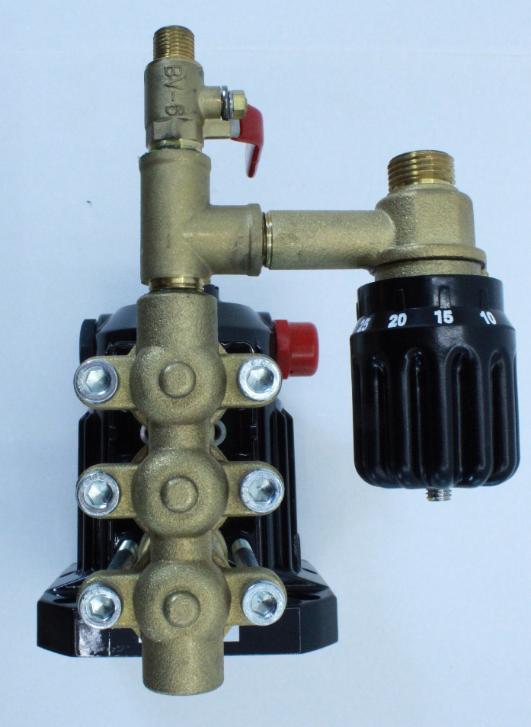
Remove the six 6mm Allen head screws retaining Manifold B.
1
4
2
5
3
6

Slide 3
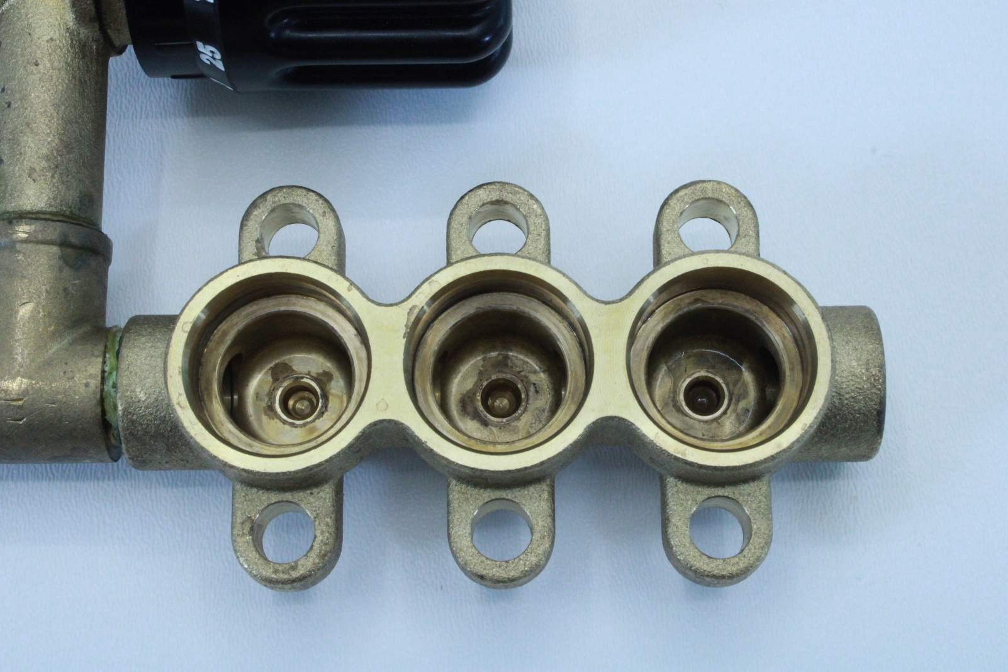
Remove Manifold B from the Cylinders. Sometimes the adapter will stay in cylinder and other times it will remain in Manifold B. Either way it will have removed for further disassembly. Use caution here so not to cause any damage to either component.
Adapter

Slide 4
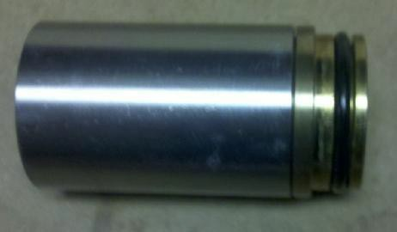
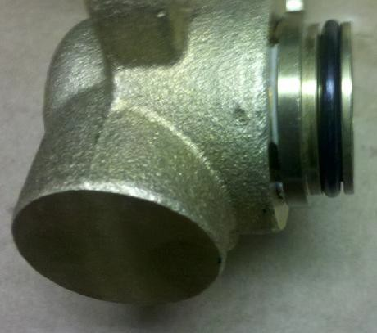
If adapter stays in cylinder and can not be removed by simply twisting them apart with your hands you may need to carefully try holding cylinder with your hands and twisting adapter with some pliers. Use caution to stay on the larger boss of the adapter or you will damage the adapter and it will have to be replaced.
If adapter stays in Manifold B and proves be difficult to remove , You may use a flat bladed screw driver to gently pry it from the manifold. There will always be a small gap between the adapter and Manifold B. Use caution not to damage either component.

Slide 5
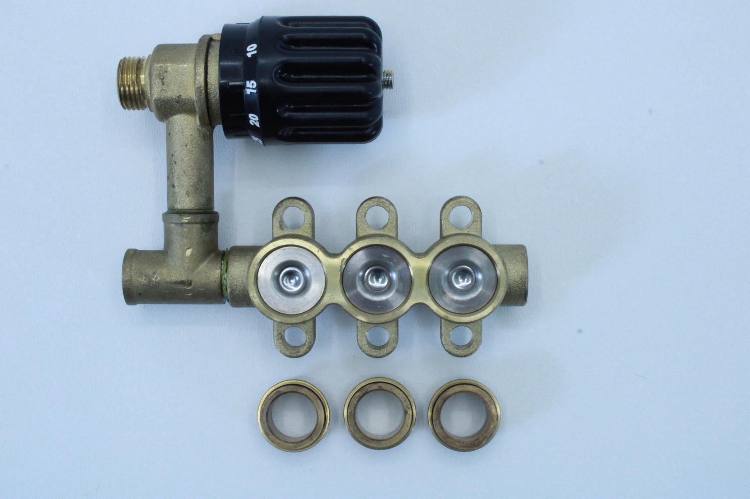
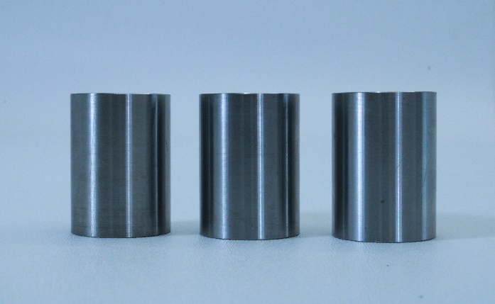
Remove the valve stack from Manifold B.
Remove the cylinders from piston rods by sliding them forward.

Slide 6
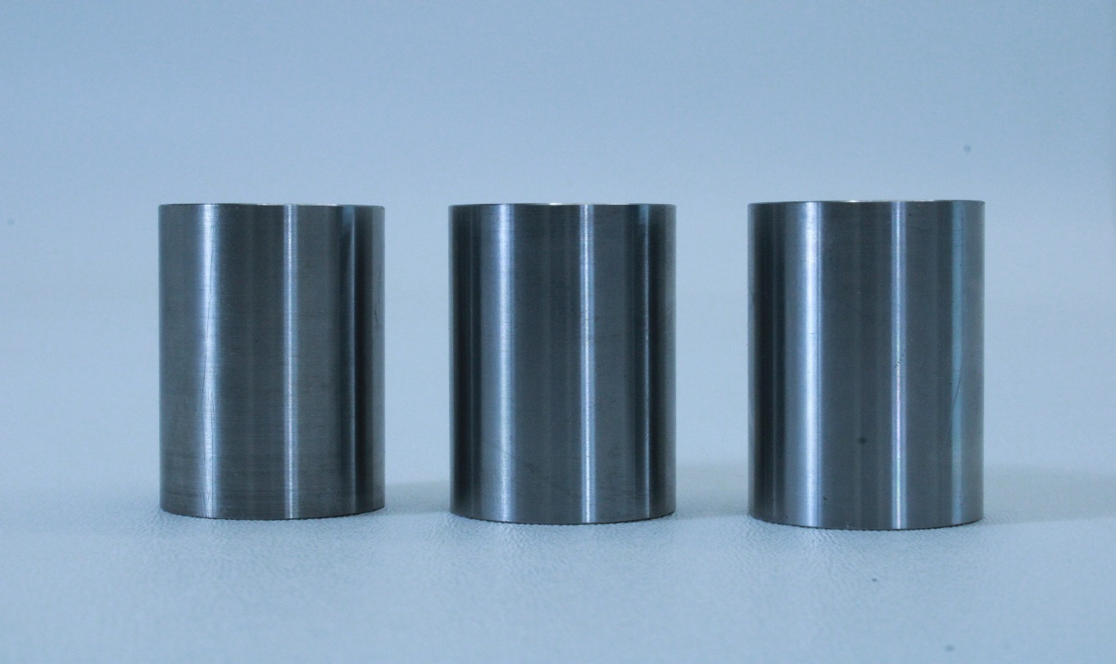
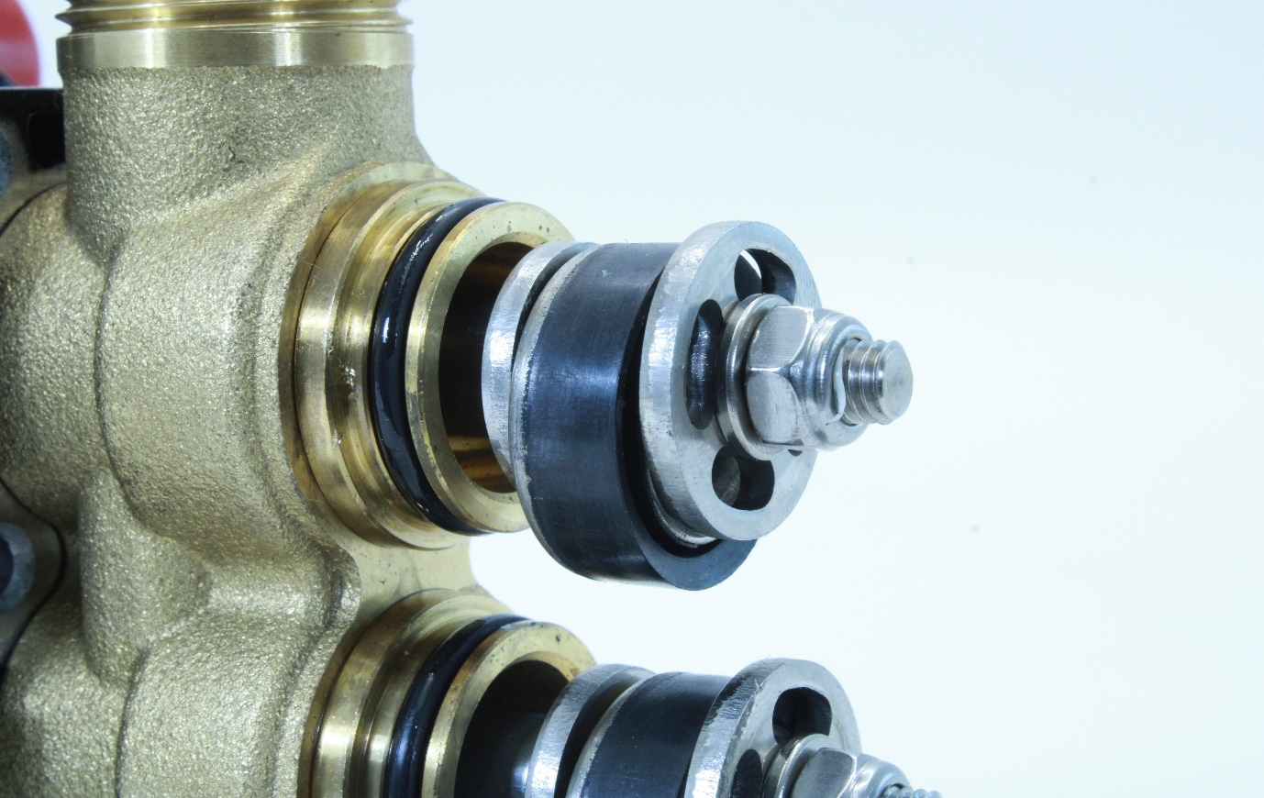
Now that you have cylinders removed from the rods. Look at the components closely . Take note how the parts are orientated for future reference.
Remove the 10mm nut retaining the Piston packing and associated items.

Slide 7
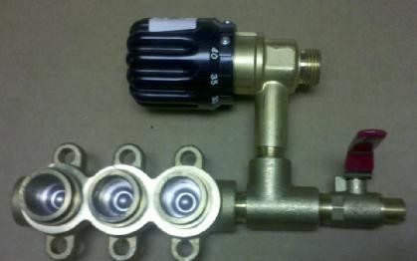
Lay out the components in order as you remove them so you will know how to reassemble them. The Square cut edge of the piston always goes toward the Manifold B .
Manifold B
Rounded Edge
Square Cut Edge

Slide 8
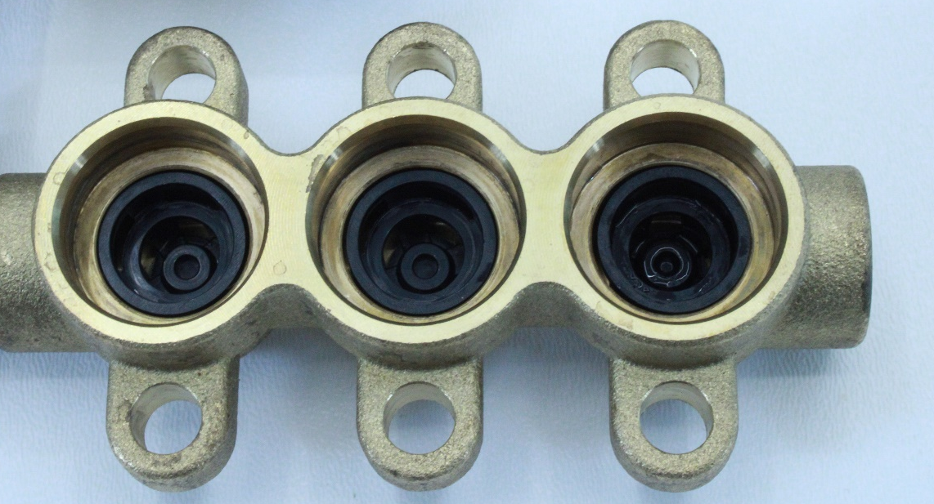
Manifold B
Clean Manifold B , make sure there is no corrosion present. Inspect the sealing surfaces for wear and flaws. Lightly lubricate sealing surfaces that will be receiving O-rings.
Lubricate with light weight oil
Install Valve sack into Manifold B

Slide 9
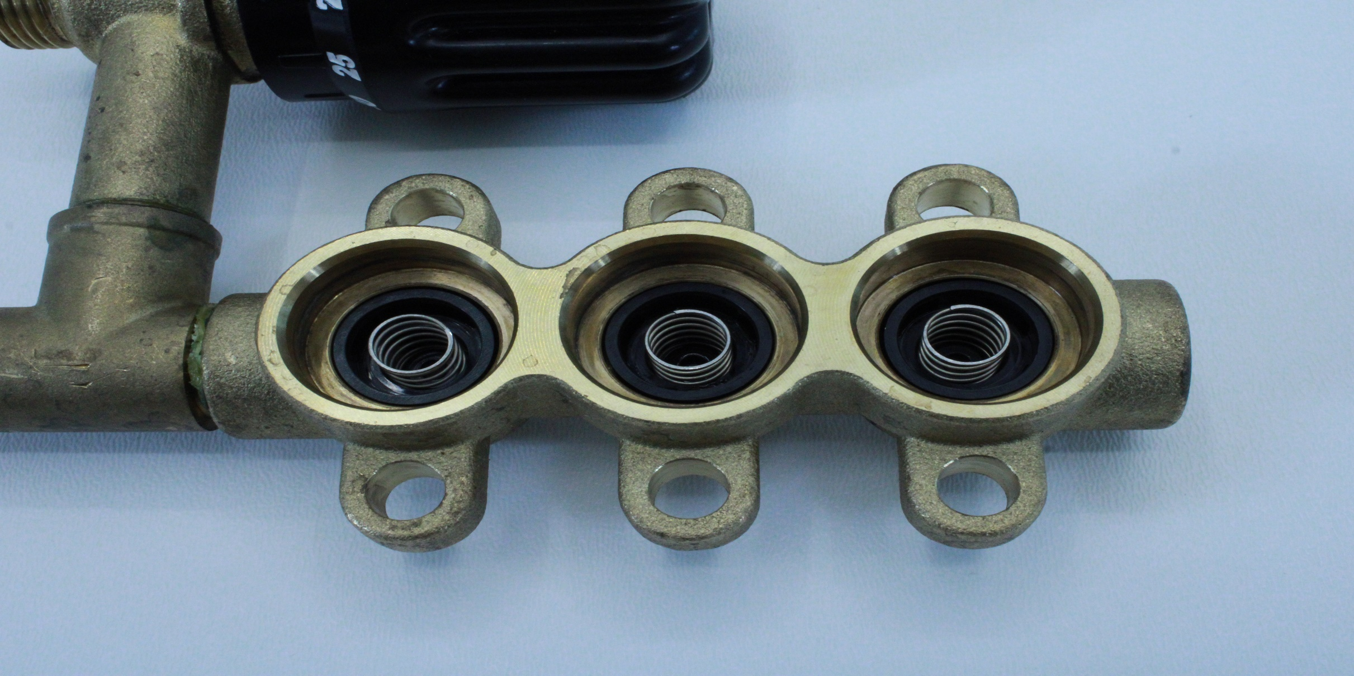
Install the three springs into the valve sacks.

Slide 10
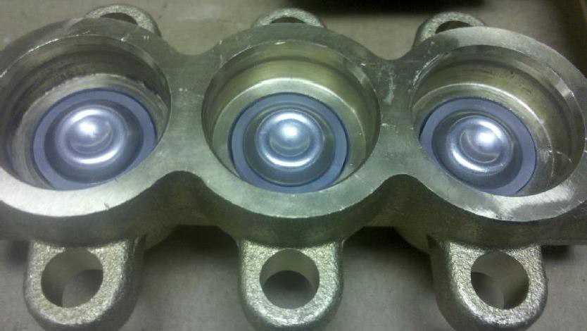
Install the three valves over the springs. The valves form a bowl shape which centers the spring.
Correct Orientation

Slide 11
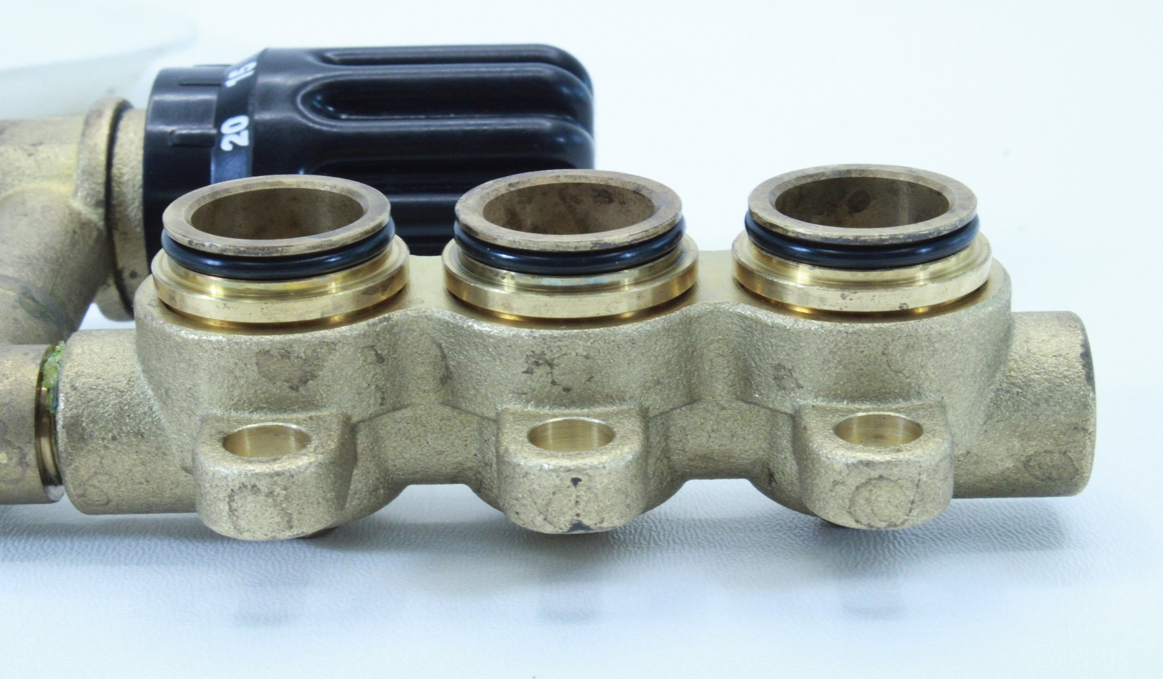
Lubricate and Install new O-rings on to each adapter. Gently push adapter into the Manifold B, This will keep the valve stacks in place. Always use new O-rings .

Slide 12
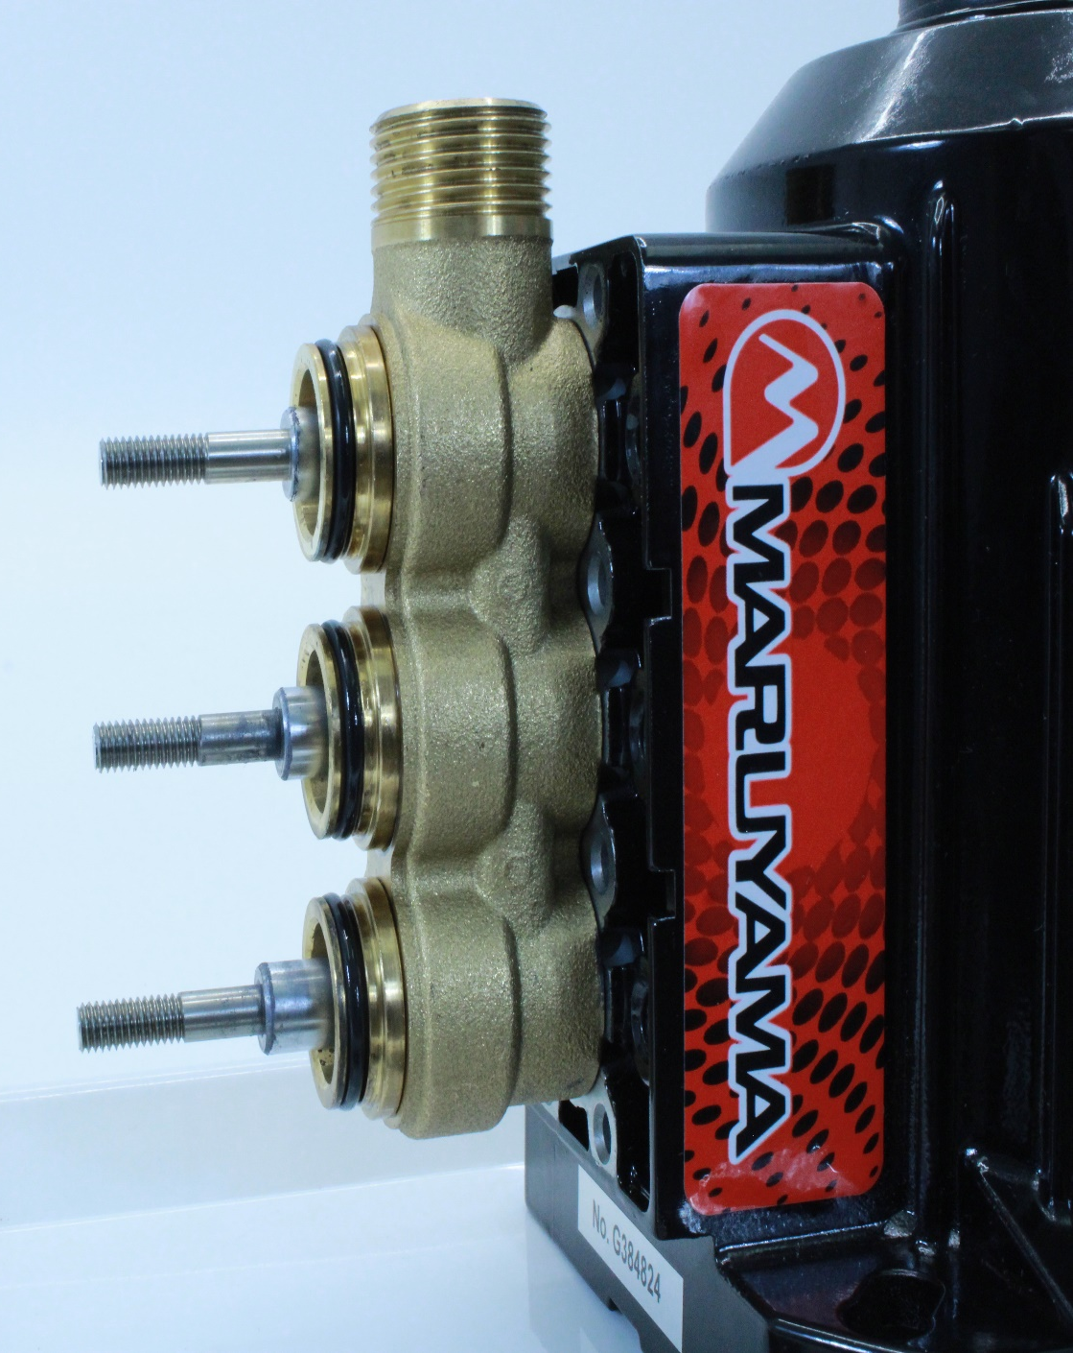
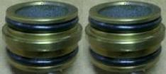
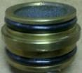
Gently remove the Adapters from Manifold A. Inspect & clean the adapters. Lubricate and replace the O- Rings for reassembly.

Slide 13
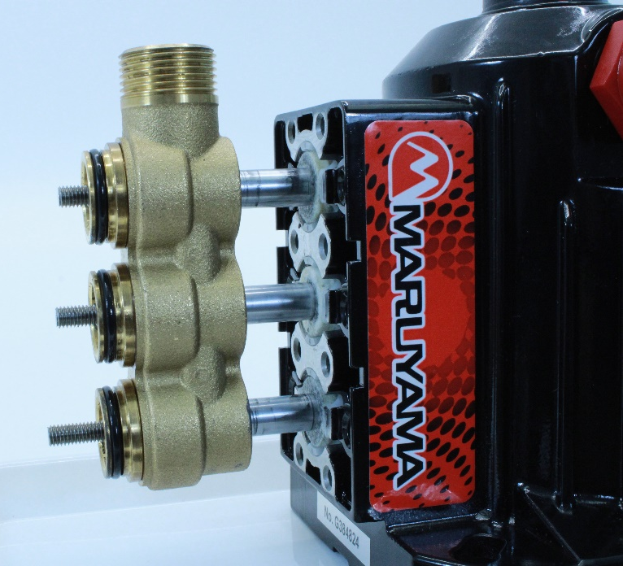
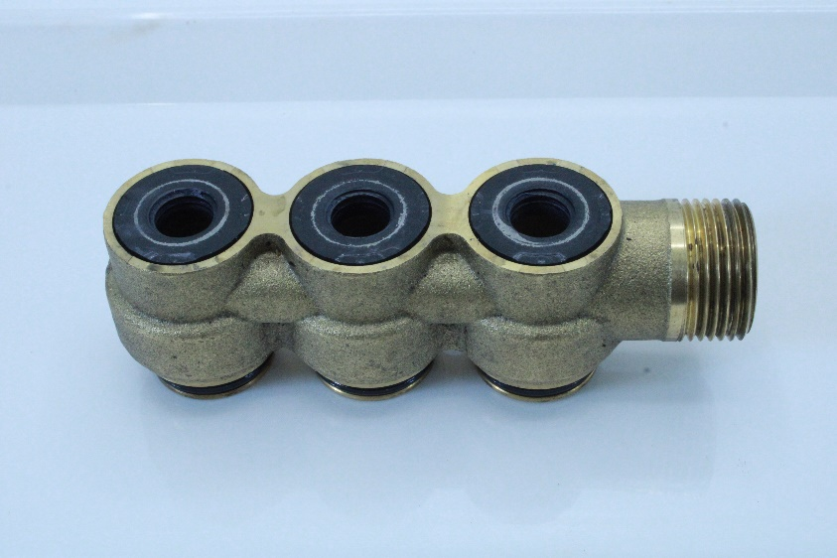
Slide Manifold A off of the rods.
Inspect the U-Packing and replace if necessary. Lubricate before reassembly.
U-Packing

Slide 14
Install Manifiold A on the rods. Remove the old O-rings and replace with new lubricated O- rings. Slide adapters into Manifold A.

Slide 15
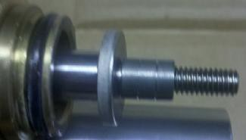
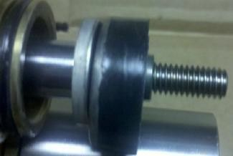
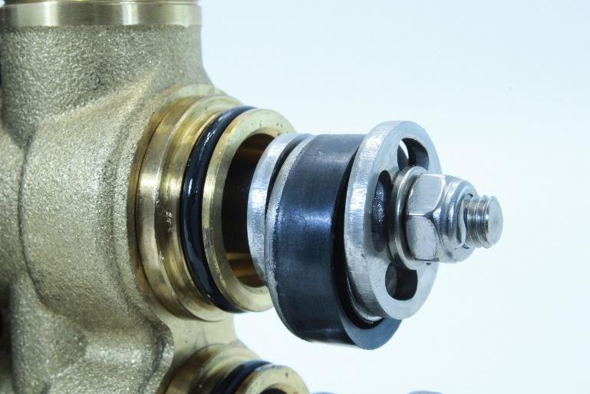
Inlet Valve Seat
Install the inlet valve seat and spacer onto the piston rod.
Piston Packing
Lubricate the piston packing with light oil and slide it over the spacer. The square cut edge goes toward manifold B.
Spacer
Piston Retainer
Spring Washer
Now install the Piston Retainer, Spring Washer, and Nut.
Finally tighten the nuts down.
Nut

Slide 16
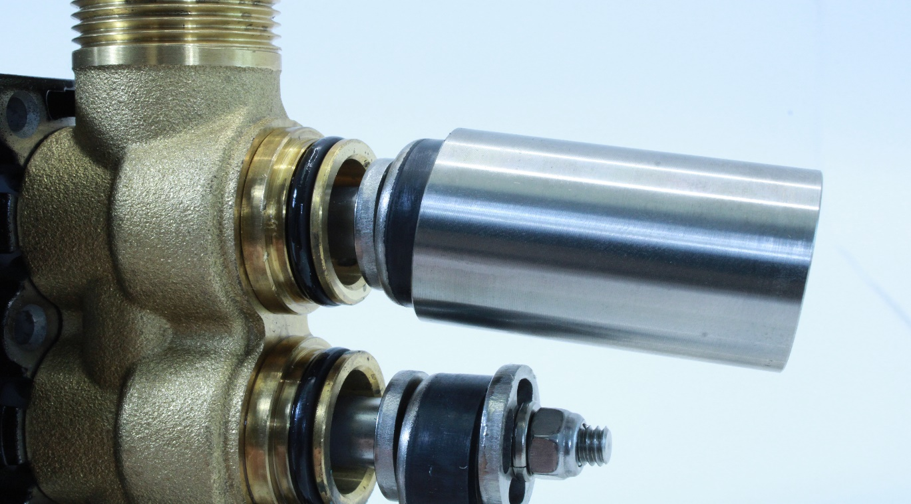
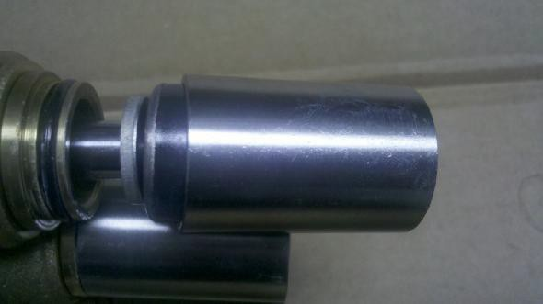
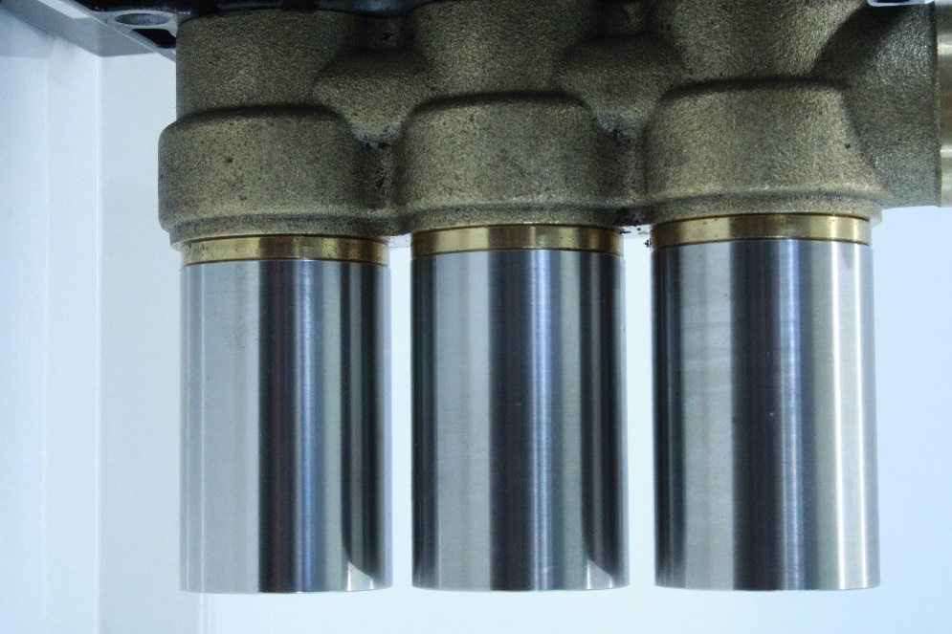
Lubricate the Cylinders and slide them over the Piston Packing. Use your fingers to compress the Piston Packing to start it into the cylinder. Never use any sharp object to do this as it will damage the Piston Packing.

Slide 17
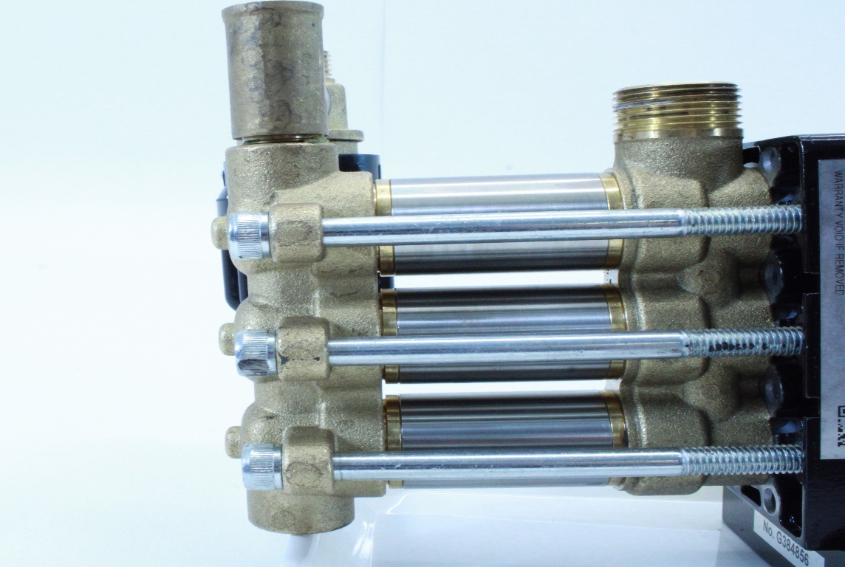
Slide Manifold B on to the cylinders. Then Install the six 6mm Allen head screws with a small amount of Loctite on each bolt.
8
6
1
3
All six bolts will need to be torqued down with
9.5 ft-lbs to 10 ft-lbs in standard or 12.7 Nm to
13.8 Nm in metric. Using
the pattern in the picture you are going to torque down the bolts in this exact order.
4
2
5
7

